Slide 1
Title of Presentation
Name
Job Title
Company

Slide 2



Introduction
Name
Job Title
Company

Slide 3
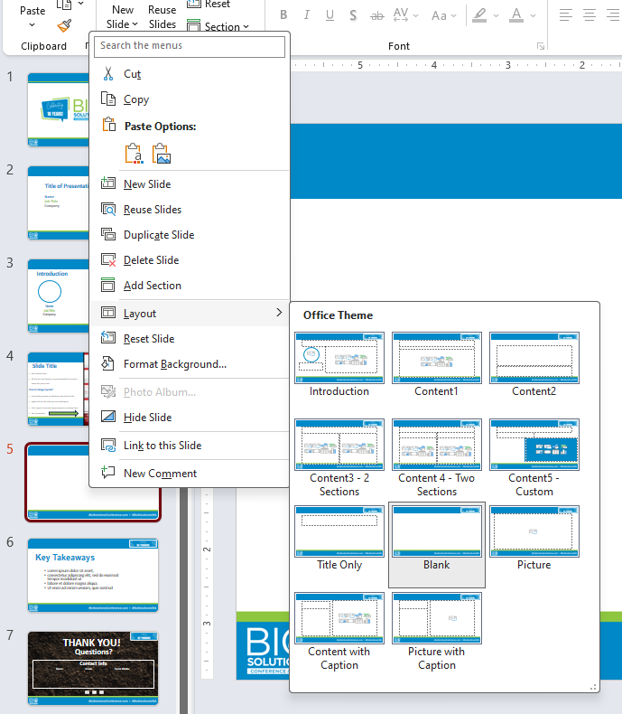
Slide Layouts
All slides are pre-templated to different layouts make it easier for you to use.
How to change layouts?
Go to slide preview on left-hand side of this slide.
Right click on the slide you are working on.
Click Layout to see the layout options to choose from and select the layout you would like to use.
See Screenshot to the right.
Notes:
Content Slide sample #1 – Right click and select layout for other layout options

Slide 5

Key Takeaways
Key Takeaway
Key Takeaway
Key Takeaway

Slide 6

THANK YOU!
Questions?
Contact Info
Your Name
Your Phone (optional)
Your Email

